Slide 1
Traffic Simulation Project
Fontys Hogeschool ICT,
Eindhoven

Slide 2
Introduction

Slide 3
Organization:
Formal Client: Mr. George
Group name: Group C
Project Leader: Govinda
Group Members: Melese
Ruth
Juarni
Wenhua Hu
Shuying Zheng

Slide 4
Purpose:
Minimizing the number of accidents by the realization of a simulation then implementing a solution in real life.

Slide 5
What the user can do:
Add & remove crossings in the grid.
Run and stop simulation
Maximize
Regulate:
* green time
* number of cars on the lane
Save and open simulation

Slide 6
Decisions Made

Slide 7
Decisions:
We use two types of Traffic system
Type One- this crossing have no pedestrians
Type two –has crossing with pedestrians
Both the Crossings have 12 lanes
Each Lane have One direction
Each Lane have one Light
The Lanes have Numbers to identify them (L1,L2,…L8) as you can see it from figure below
Type two crossing have two extra lane

Slide 8
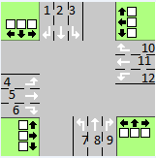
Crossing type1:
Same green Lighting System groups
L1+L2+L8+L9 group-1
L5+L6+L10+L11 group-2
L12+L4+L1 group-3
L3+L7+L6 group-4

Slide 9
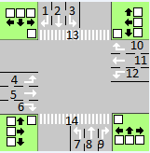
Crossing type2:
L1+L2+L8+L9 group-1
L5+L6+L10+L11 group-2
L12+L4+L1 group-3
L3+L7+L6 group-4
L5+L11+Pedestrain-1+
pedestrian-2 group-5

Slide 10
The application
& Demo

Slide 11
Question?

